Slide 1
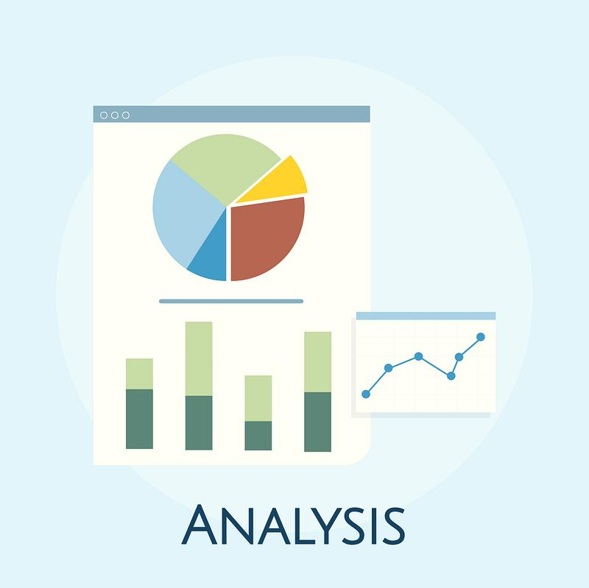






IBM Data Analyst Capstone Project
Ayush Tyagi
August 14, 2024

Slide 2



INDEX
Executive Summary
Introduction
Methodology
Results
  Visualization – Charts
  Dashboard
Discussion
  Findings & Implications
Conclusion
Appendix

Slide 3

EXECUTIVE SUMMARY
Project based on developing an interactive dashboard in IBM Cognos Cloud showcasing valuable insights from two datasets, using the most appropriate visualization available on the IBM Cognos platform
Assembled to be visually appealing and easy to understand
Contains data analysis that is aimed to be intuitive and allows drill-down

Slide 4

INTRODUCTION
The objectives of this project are:
  Make use of interactive visualizations in IBM Cognos to improve charts
  Demonstrate the use of correct chart types to use to visualize data
  Create a dashboard that helps visualize the key points of the survey dataset

Slide 5

METHODOLOGY
Data ETL
Collected and imported data into Cognos environment
Datasets used:
m5_survey_data_demographics.csv
m5_survey_data_technologies_normalised.csv
Designing
Created required tabs and chose appropriate layouts
Populating the Charts
Created 12 different visualizations using appropriate filters, variables and toggle options
Exporting
Exported the chart as PDF to GitHub for easy sharing
The process consisted of four major steps

Slide 6
RESULTS
The following charts were developed as part of this project
Current Technology Usage
Top 10 Languages
Top 10 Databases
Platforms
Top 10 Web Frameworks
Future Technology Usage
Top 10 Languages Desired for the Next Year
Top 10 Databases Desired for the Next Year
Desired Platforms for the Next Year
Top 10 Web Frameworks Desired for the Next Year
Demographics
Respondent Classified by Work Experience
Respondent Count for Countries
Respondent Count by Age
Respondent Count by Gender and Classified by Education Level

Slide 7
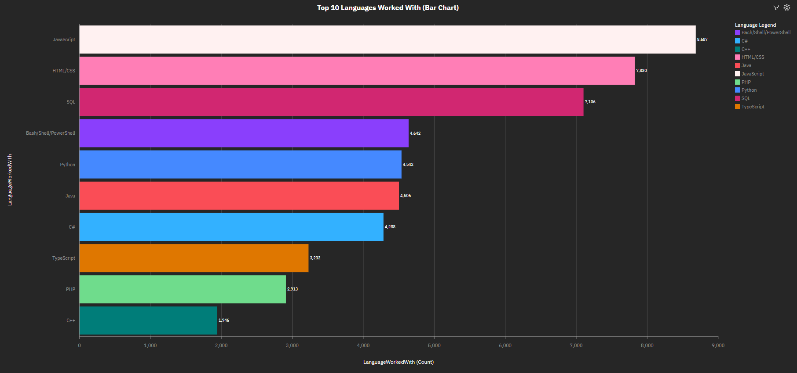
PROGRAMMING LANGUAGE TRENDS: CURRENT YEAR

Slide 8
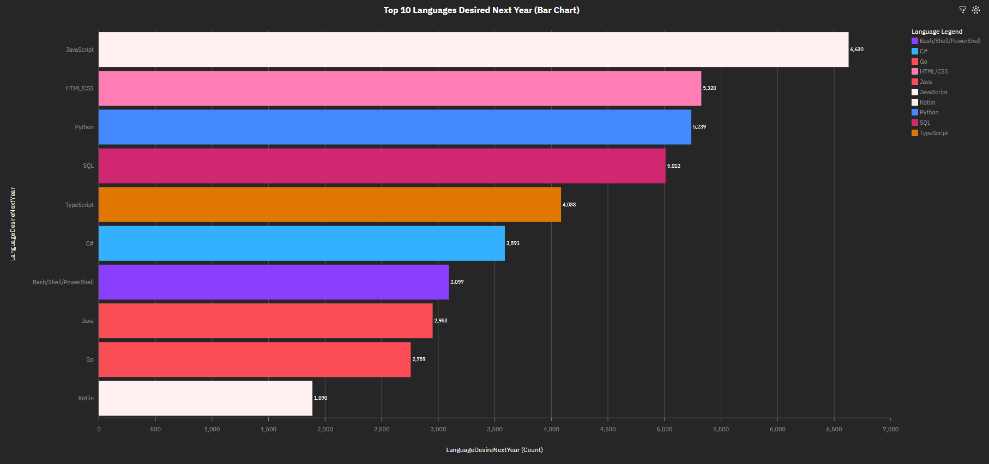
PROGRAMMING LANGUAGE TRENDS: NEXT YEAR

Slide 9
PROGRAMMING LANGUAGE TRENDS - FINDINGS & IMPLICATIONS
Findings
JavaScript: Top language in both years
Python: Demand significantly increases for the next year
TypeScript: Shows a notable rise in demand
Implications
JavaScript: Essential for web development; key skill for developers
Python: Critical for data science and automation roles
Typescript: Important for building scalable and maintainable applications

Slide 10
PROGRAMMING LANGUAGE TRENDS - FINDINGS & IMPLICATIONS
JavaScript
Finding: Top language in both years
Implication: Essential for web development; key skill for developers
Python
Finding: Demand significantly increases for the next year
Implication: Critical for data science and automation roles
TypeScript
Finding: Shows a notable rise in demand
Implication: Important for building scalable and maintainable applications

Slide 11
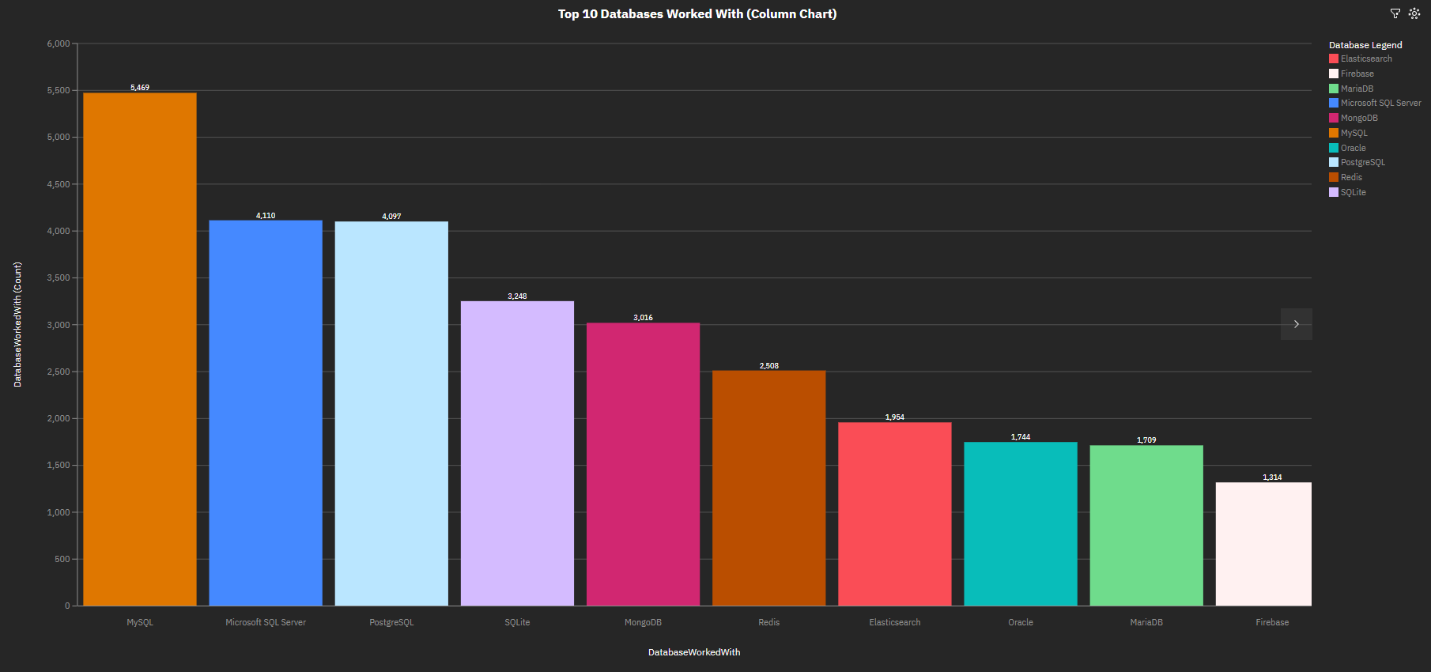
DATABASE TRENDS: CURRENT YEAR

Slide 12
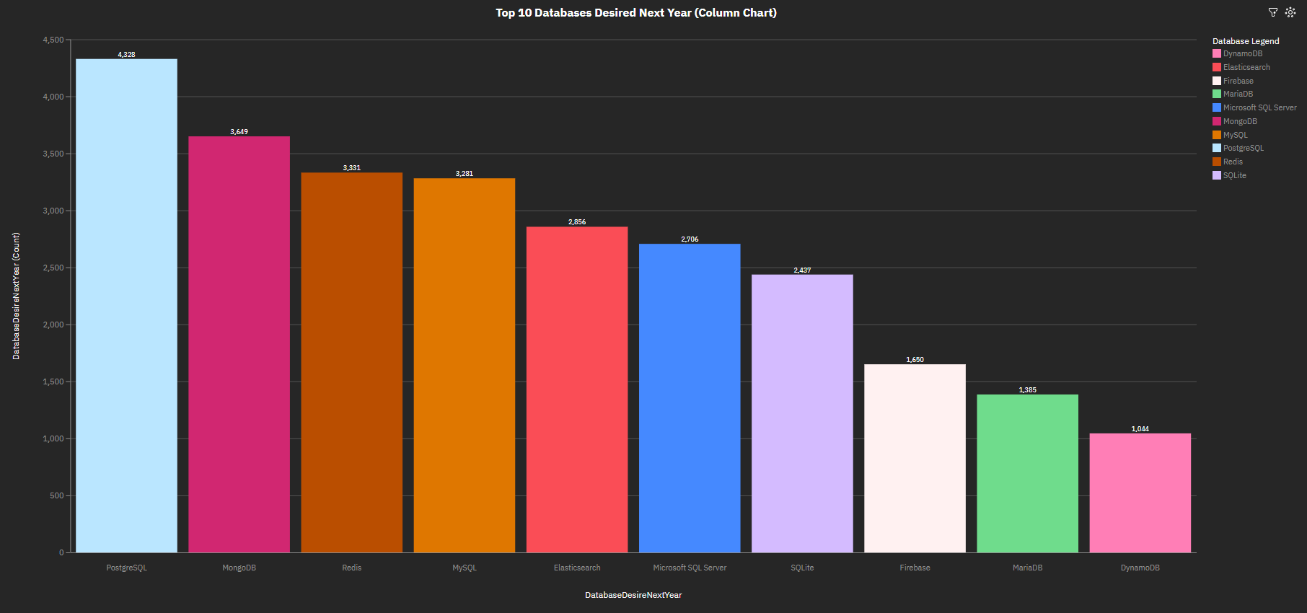
DATABASE TRENDS: NEXT YEAR

Slide 13
PROGRAMMING LANGUAGE TRENDS - FINDINGS & IMPLICATIONS
Growth in Database Workload
Finding: Shift from cost management to growth and scalability
Implication: Prioritizing efficient databases for increased workloads
Top Databases
Finding: PostgreSQL and MySQL remain consistently popular
Implication: Continued investment in reliable, high-performance databases
Emerging Databases
Finding: New databases projected to grow significantly next year
Implication: Exploring innovative options to stay competitive

Slide 14

DASHBOARD
GitHub Link: Capstone Project – Cognos Dashboard.pdf

Slide 15
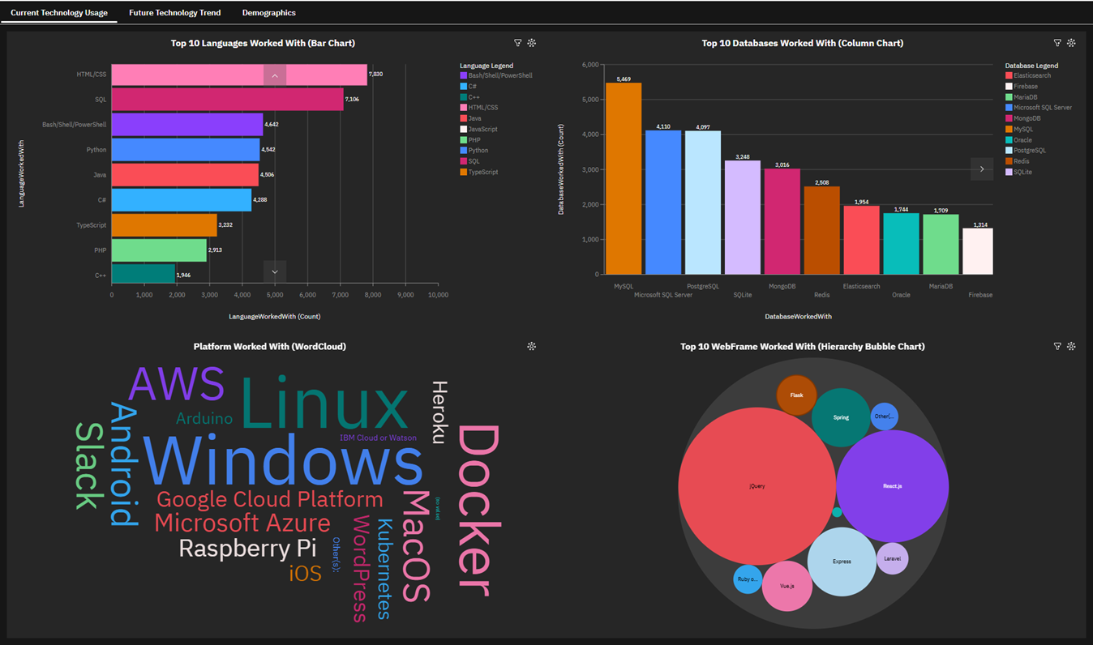
COGNOS DASHBOARD: CURRENT YEAR

Slide 16
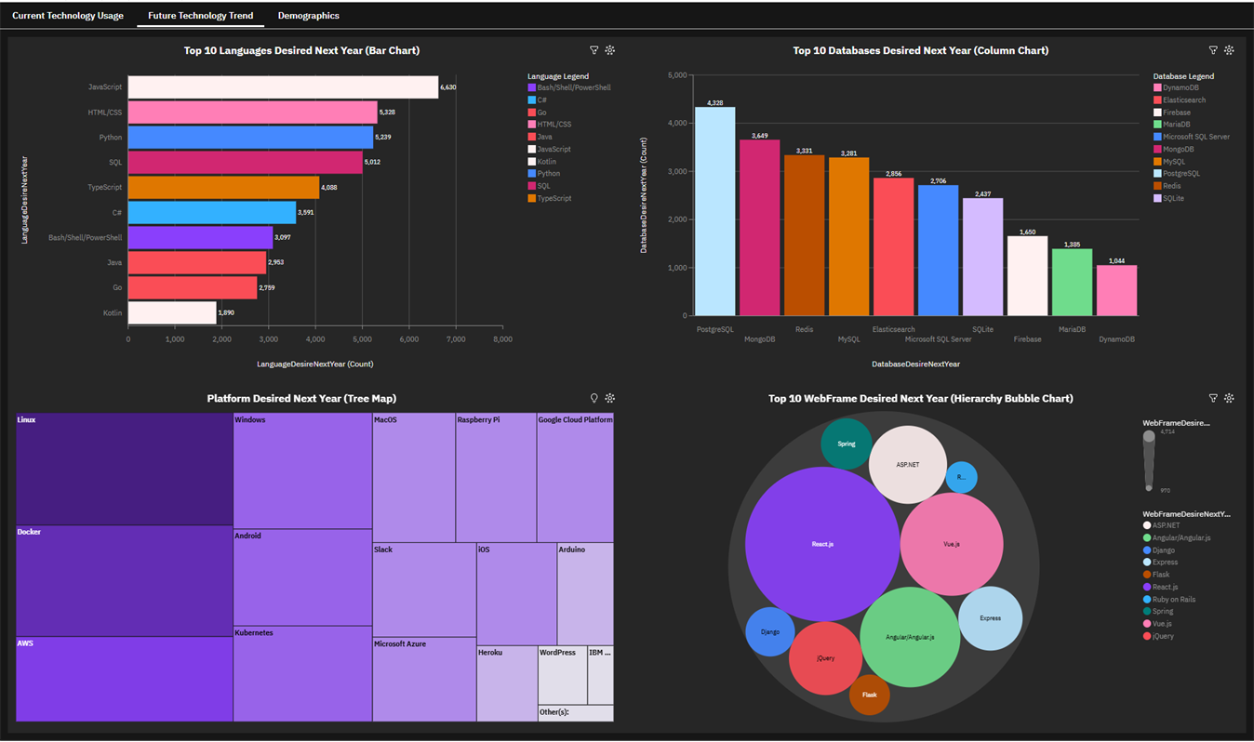
COGNOS DASHBOARD: NEXT YEAR

Slide 17
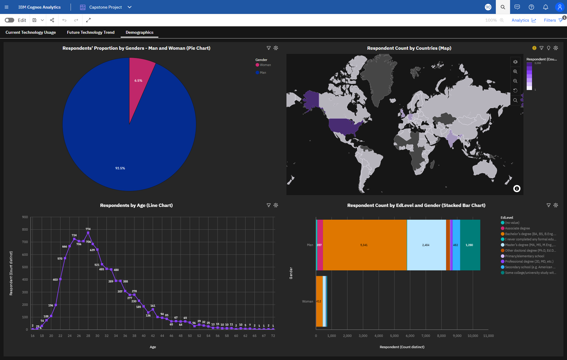
COGNOS DASHBOARD: DEMOGRAPHICS

Slide 18
DISCUSSION: FINDINGS & IMPLICATIONS
Findings
Leading Language: JavaScript
Shift from MySQL to PostgreSQL, MongoDB
Age-group: 20-40 has the highest share
Gender-wise distribution:
  Males 93.5%
  Females 6.5%
Implications
JavaScript remains crucial for web development, continuing its widespread use
PostgreSQL based projects could grow in the coming years
NoSQL databases like MongoDB will see a usage spike in future
Programs supporting Women in Tech should be promoted to help the female aspirants grow

Slide 19

CONCLUSION
JavaScript continued dominance, Python and TypeScript’s ascending trends, emphasize the importance of these languages in modern development.
PostgreSQL and MySQL remain dominant, indicating their continued reliability and performance. Emerging databases are gaining traction, suggesting a shift towards innovative solutions.
Additionally, demographic data highlights a need for targeted strategies to diversify respondent participation across gender, age, and geographical locations.

Slide 20

APPENDIX
Additional charts follow

Slide 21
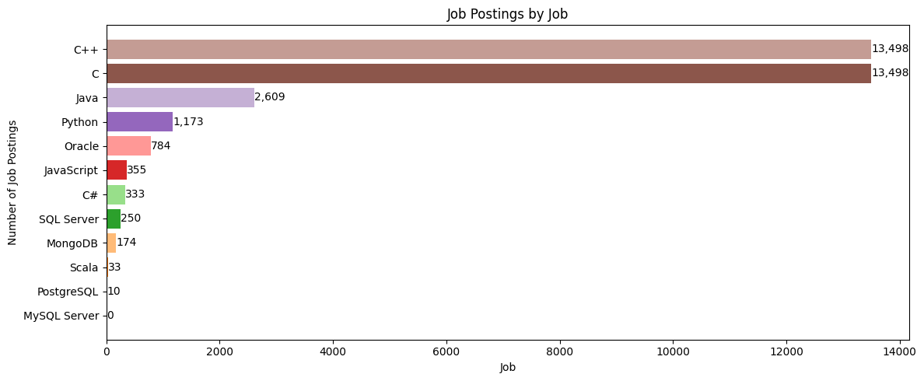
JOB POSTINGS (Bar Chart)

Slide 22
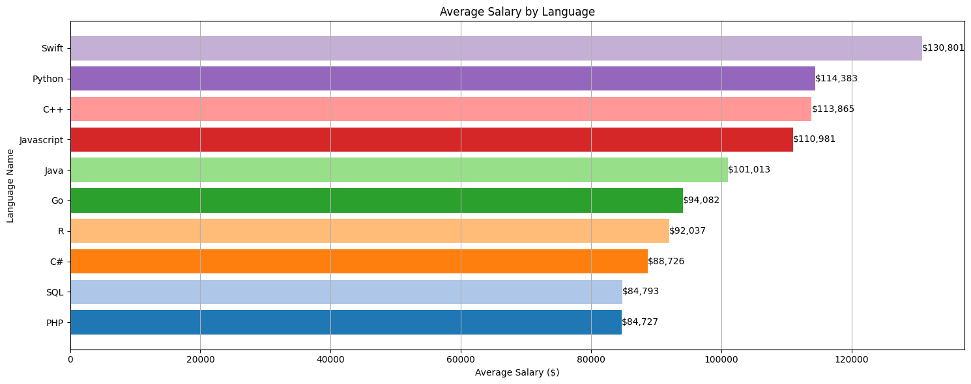
POPULAR LANGUAGES (Bar Chart)

Slide 23
Thank You

